Slide 1
Document Verification Using AI Assistant
Aayush Anand

Slide 2
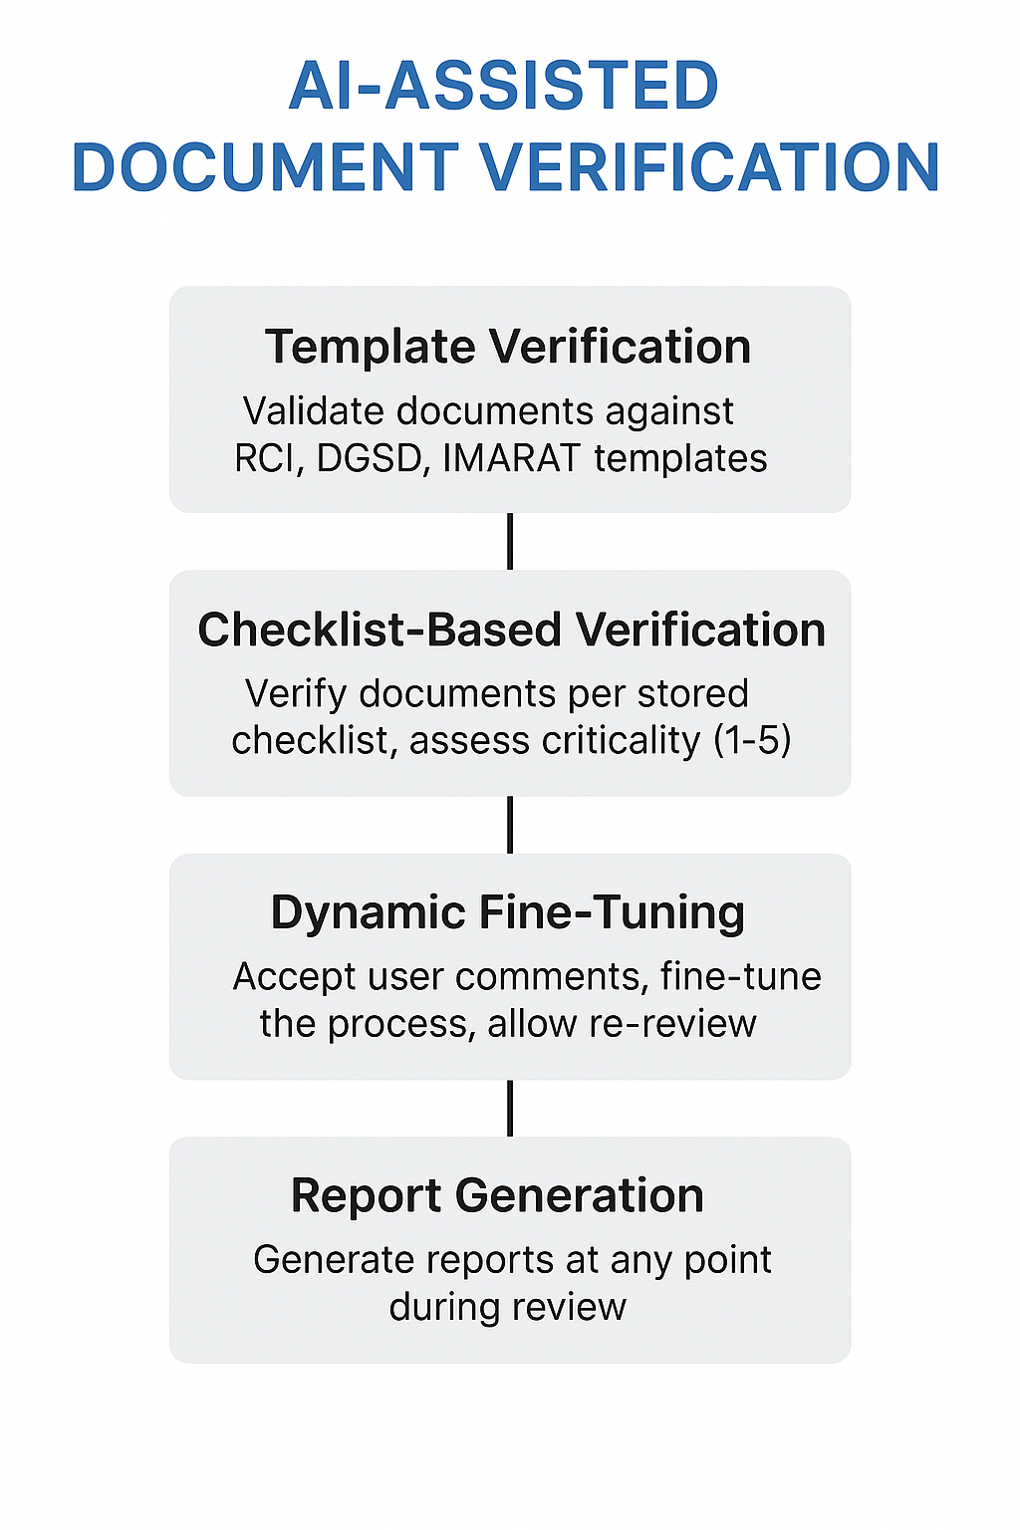
Problem Statement
To develop a tool that assists users (DSQA members) in document review. The tool will support the following key functionalities:
Template Verification – Validate documents against predefined templates, such as RCI Template, DGSD Template, and IMARAT Template.
Checklist-Based Verification – Verify documents according to a stored checklist and determine the criticality of observations, categorized on a scale of 1–5, where 1 = Major and 5 = Suggestion.
Dynamic Fine-Tuning – Accept user-specific comments and fine-tune the verification process accordingly. The tool should also allow reversal of such fine-tuning and support re-review to reassess observation criticality.
Report Generation – Provide the option to generate a report at any point during the review process.

Slide 3
Literature Review
1. Related Technologies
Document AI Services – Google Document AI (extracts key fields from contracts), Azure Form Recognizer (reads scanned forms), Amazon Textract (parses invoices and receipts).
OCR Tools – Tesseract (reads text from scanned QA reports), EasyOCR (recognizes handwritten inspection notes).
NLP Models – BERT (semantic matching for compliance terms), LayoutLM (extracts table data from QA checklists).
2. Related Applications
Legal Document Analysis – AI extracting clauses and compliance risks in contracts (e.g., Kira Systems).
Invoice & Form Processing – Automated billing data entry from PDF invoices (e.g., UiPath Document Understanding).
Automated QA Verification – AI detecting missing sections in aerospace testing reports.
3. Limitations in Existing Work
No domain-specific verification for RCI/DGSD/IMARAT templates.
No checklist-based criticality scoring – E.g., current tools can flag “missing section” but not classify it as Major or Suggestion.

Slide 4
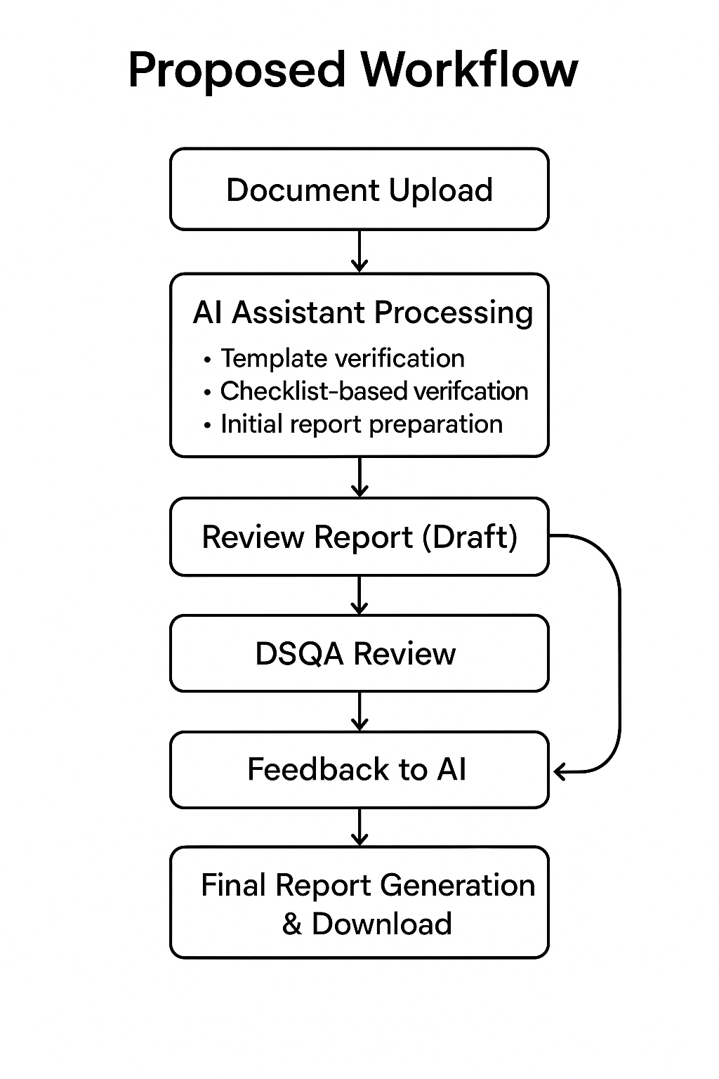
Approach
Document Upload – User submits document (PDF/Word).
AI Assistant Processing – Performs template verification, checklist-based validation, and generates an initial draft report.
Draft Review Report – Preliminary findings highlighting compliance issues and suggestions.
DSQA Review – Human reviewers assess the AI-generated draft.
Feedback to AI – DSQA provides corrections, comments for re-processing.
Re-Processing by AI – AI incorporates feedback, reassesses criticality, and updates the review.
Final Report Generation – Comprehensive report prepared with compliance status, observations, and suggestions, available for download.

Slide 5
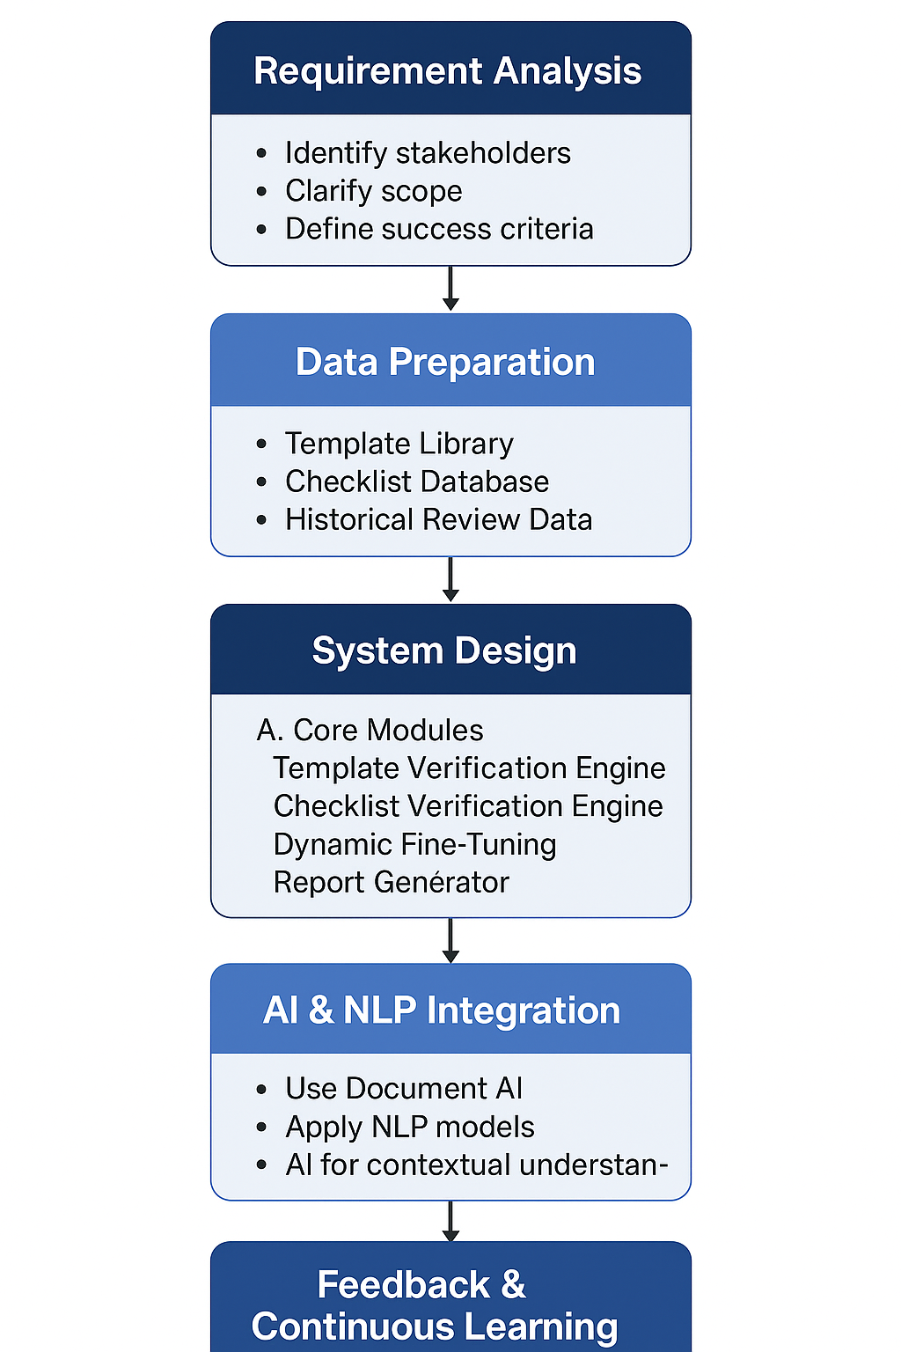
Progress
1. Requirement Analysis
Stakeholders: DSQA, QA leads, authors.
Scope: RCI/DGSD/IMARAT templates, checklist categories.
Success Criteria: Accuracy %, review time reduction, clarity of reports.
2. Data Preparation
Template Library: Digital RCI/DGSD/IMARAT docs (Word/PDF).
Checklist DB: Structured list with criticality (1–5).
Historical Data: Past reviewed docs + comments for fine-tuning.
3. System Design
Template Verification: OCR + compliance checks.
Checklist Verification: Match content to checklist, assign criticality.
Dynamic Fine-Tuning: User feedback loop, per-user prefs, rollback option.
Report Generator: PDF/Excel with compliance summaries, critical issues.
4. AI & NLP Integration
Extraction: Document AI for content.
Verification: BERT/GPT models for semantic checklist checks.
Classification: AI for contextual issue categorization.
5. Feedback & Continuous Learning

Slide 6
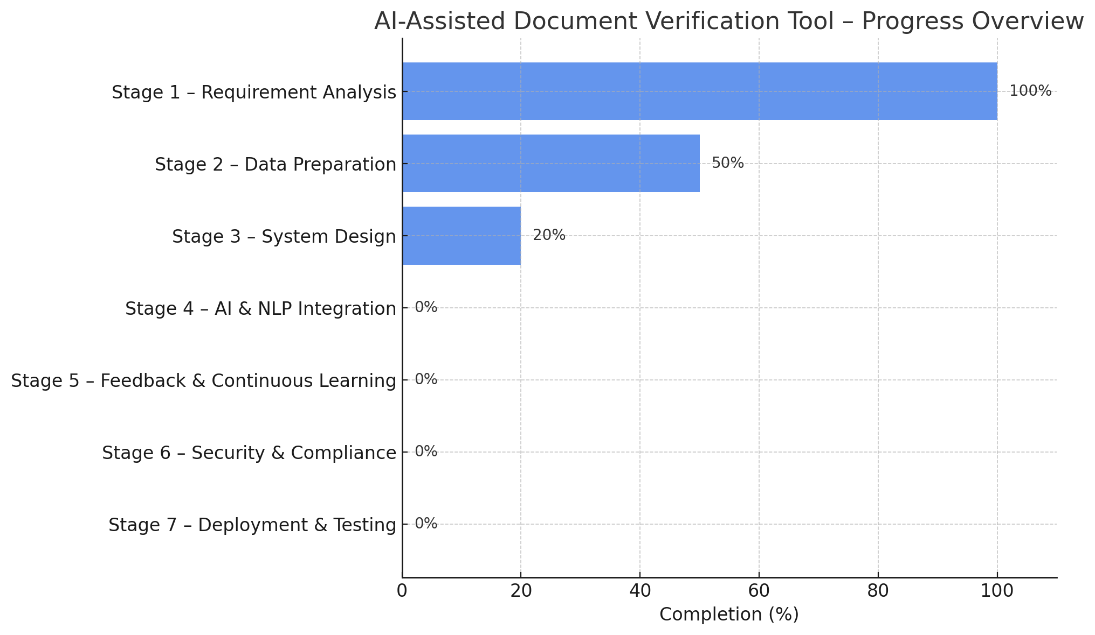

Slide 7
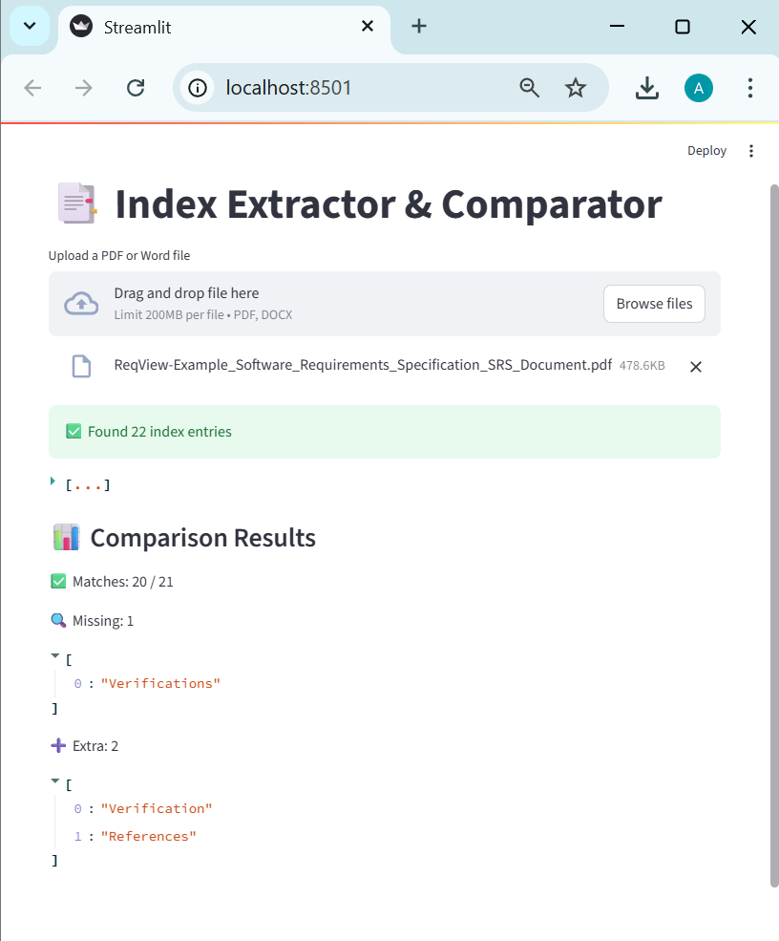
Work Till Now
1. PDF Index Extraction & Matching
Extracted index from PDF → stored in list.
Compared with predefined required index list.
Streamlit UI: shows extracted index, missing, extra elements.
2. Research on Evaluation Metrics
BLEU, which measures n-gram precision b/w candidate and reference text.
ROUGE-L, which assesses recall and sequence similarity through the longest common subsequence.
BERTScore, which evaluates semantic similarity between generated and reference text using contextual embeddings.
GPT Score, which leverages large language models to assess output quality based on task-specific prompts.
3. Libraries Exploration
For GUI: Streamlit. Tkinter
EXtraction: fitz, python-docx. docx2text,
OCR purpose: pytesseract

Slide 8
Thank You

